Slide 1
Operators & Control Statements

Slide 2
Bitwise operators
Java defines several bitwise operators that can be applied to the integer types: long, int, short, char, and byte.
the bitwise operators manipulate the bits within an integer: effects such manipulations may have on a value !
it is useful to know how Java stores integer values and how it represents negative numbers

Slide 3
Bitwise operators: Example
42 in binary is 00101010
-42 is two’s complement of 00101010
11010101 1 ------------- 11010110
high order bit represents the sign
to decode -42 : invert the digits and add 1 again

Slide 4
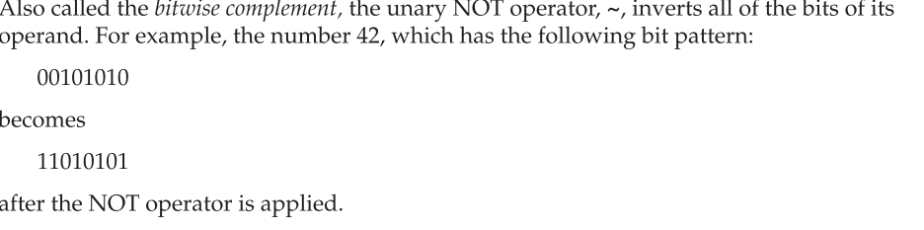
The Bitwise NOT

Slide 5
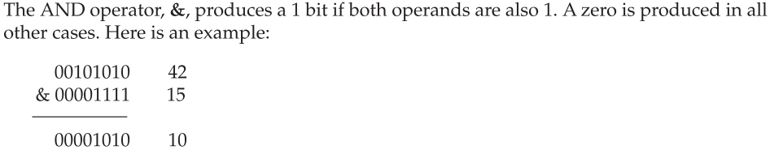
The Bitwise AND

Slide 6
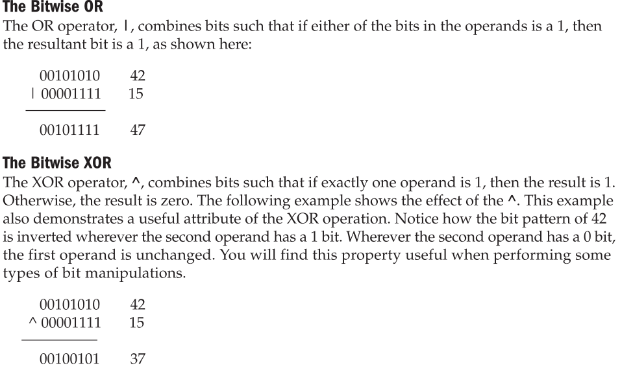
Bitwise OR and XOR

Slide 7
Left shift <<
byte a = 64, b;
int i;
i = a << 2;
b = (byte) (a << 2);

Slide 8
Left shift <<
0000_0000_0000_0000_0000_0000_0100_0000
<<1
0000_0000_0000_0000_0000_0000_1000_0000
<<1
0000_0000_0000_0000_0000_0001_00000000
Notes:
INT : 64 ; 128; 256
BYTE: 64; -128; 0

Slide 9
Left shift <<
0XFFFFFFE
0000_1111_1111_1111_1111_1111_1111_1110
<<1
0001_1111_1111_1111_1111_1111_1111_1100
<<1
0011_1111_1111_1111_1111_1111_1111_1000
<<1
0111_1111_1111_1111_1111_1111_1111_0000
<<1
1111_1111_1111_1111_1111_1111_1111_0000

Slide 10
536870908
1073741816
2147483632
-32

Slide 11
Right shift >>
00100011 35
>> 2
00001000 8

Slide 12
Right shift >> (remainder discarded]
00100011 35
>> 2
00001000 8

Slide 13
Right shift >> (sign extension)
11111000 –8
>> 1
11111100 –4
-1 ???

Slide 14
Unsigned Right shift
–1 in binary as an int
11111111 11111111 11111111 11111111
>>>24
00000000 00000000 00000000 11111111
255 in binary as an int

Slide 15
Unsigned Right shift *
smaller values are automatically promoted to int in expressions.
This means that sign-extension occurs and that the shift will take place on a 32-bit rather than on an 8- or 16-bit value.
That is, one might expect an unsigned right shift on a byte value to zero-fill beginning at bit 7
But this is not the case, since it is a 32-bit value that is actually being shifted

Slide 16
Bitwise Operator Compound Assignments
a = a >> 4;
a >>= 4;
a = a | b;
a |= b;

Slide 17
Control Statements : switch
byte, short, int, char, or an enumeration
beginning with JDK 7, you can use a string to control a switch statement
The switch differs from the if in that switch can only test for equality, whereas if can evaluate any type of Boolean expression.
No two case constants in the same switch can have identical values. Of course, a switch statement and an enclosing outer switch can have case constants in common.
A switch statement is usually more efficient than a set of nested ifs.

Slide 18
Control Statements : for
for(int i=0;i<10;i++)
Using commas
Different conditional test
for( ; !done; )
for( ; ; )

Slide 19
Enhanced for
int nums[] = { 1, 2, 3, 4, 5, 6, 7, 8, 9, 10 };
int sum = 0;
for(int i=0; i < 10; i++) sum += nums[i];

Slide 20
Enhanced for
int nums[] = { 1, 2, 3, 4, 5, 6, 7, 8, 9, 10 };
int sum = 0;
for(int x: nums) sum += x;

Slide 21
Enhanced for : multidimensional arrays
for(int x[] : nums) {
for(int y : x) {
System.out.println("Value is: " + y);
sum += y;
}
}

Slide 22
Jump statements
Break
Continue
return

